Slide 1


Mistral’s Lean Efficiency: Mistral stands out with its 7 billion parameters, which is significantly smaller than many of its counterparts. Despite this, it shows remarkable performance and is especially notable for its manageability. The entire Mistral model is about 5 GB, making it practical to run on ordinary computers with around 16 GB of RAM.
Chamabouabd

Slide 2
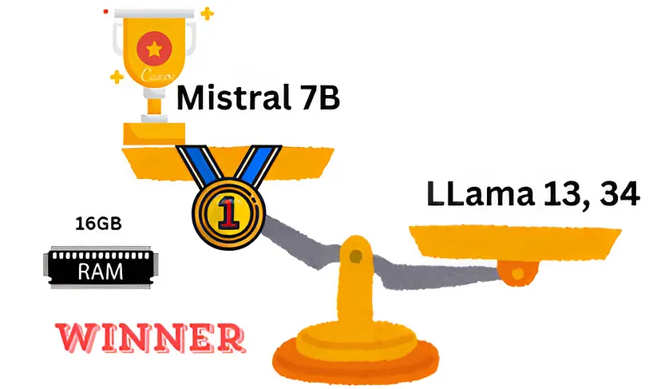
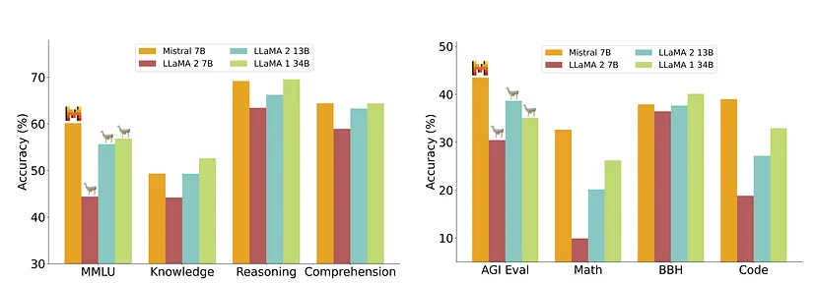
Chamabouabd

Slide 3
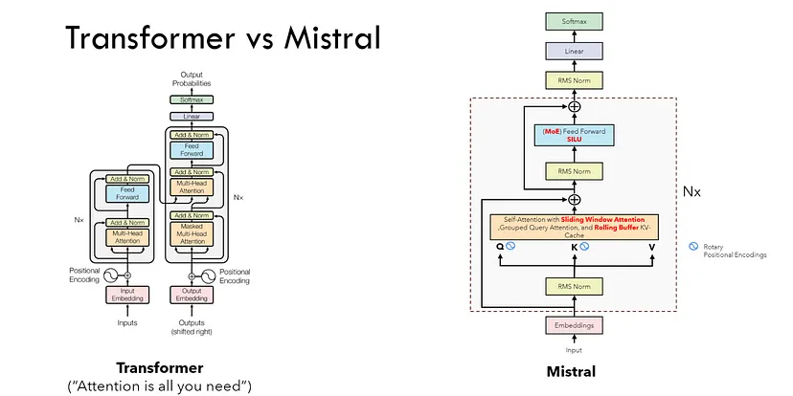
This figure shows the Performance of Mistral 7B and different Llama models on a wide range of benchmarks.
MMLU (Massive Multitask Language Understanding) is a new benchmark designed to measure knowledge acquired during pretraining by evaluating models . This makes the benchmark more challenging and more similar to how we evaluate humans. The MMLU benchmark covers 57 subjects across STEM, the humanities, the social sciences, and more.
Chamabouabd

Slide 4
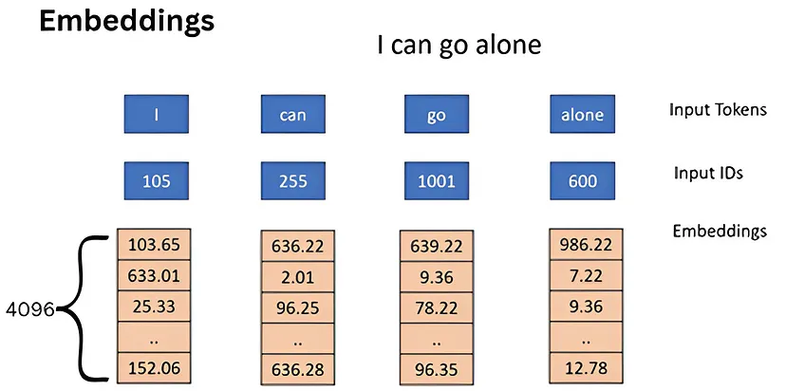
the values of embeddings initially are randomly in the training phase the model update Thies values until it will have a manful meaning
Chamabouabd

Slide 5
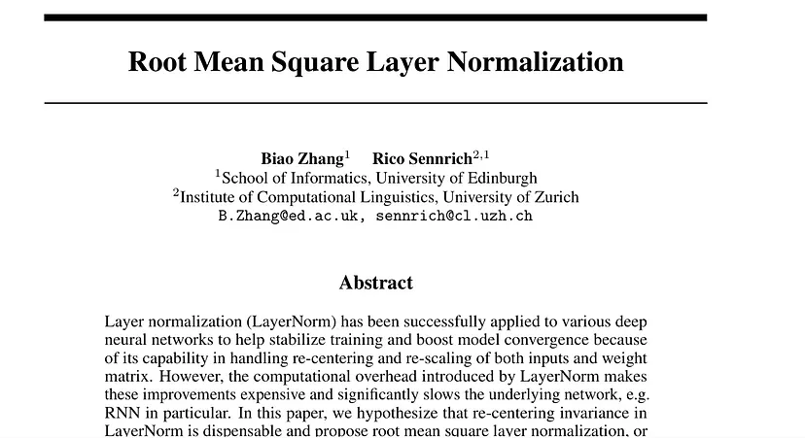
Why RMS norm ?
RMS normalization can help to scale the gradients during training in a way that can prevent them from becoming too large or too small.
Chamabouabd

Slide 6
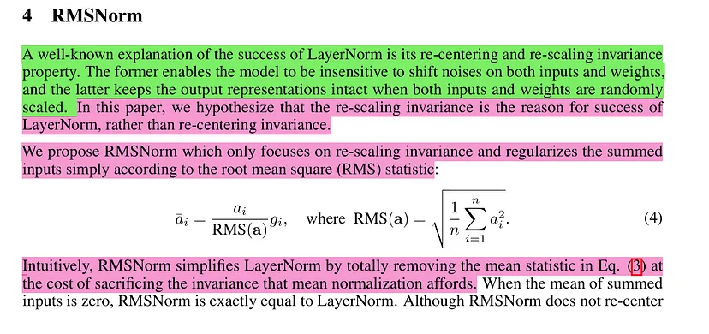
Chamabouabd

Slide 7
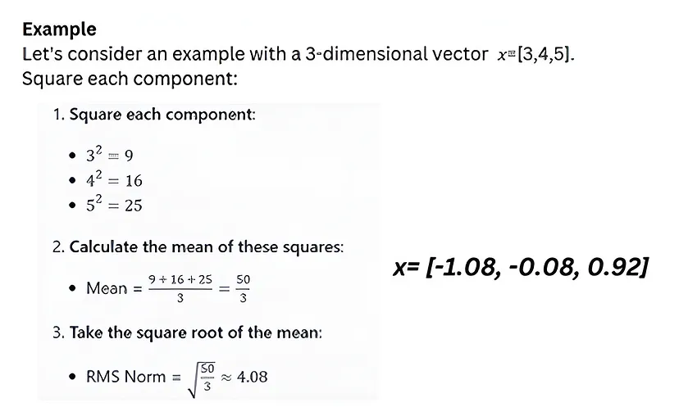
Chamabouabd

Slide 8
RMS Norm Requires less computation compared to Layer Normalization.
after scaling the values, we need to add information about the position of the tokens
issue !
“the dog chases the pig” “the pig chases the dog”
The model is not able to see any difference between these two sentences.
solution: Positional Encoding
What Is Positional Encoding?
Positional encoding describes the location or position of an entity in a sequence so that each position is assigned a unique representation. There are many reasons why a single number, such as the index value, is not used to represent an item’s position in transformer models. For long sequences, the indices can grow large in magnitude. If you normalize the index value to lie between 0 and 1, it can create problems for variable length sequences as they would be normalized differently.
Chamabouabd

Slide 9
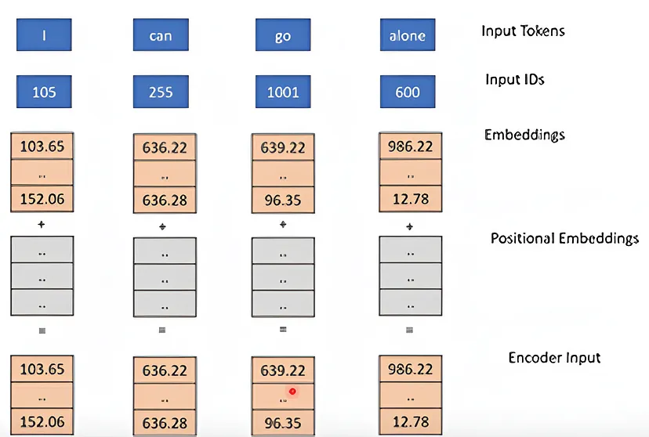
here we add a positional Embedding to the Embaddings vector that
The goal of adding a positional embedding to the embedding vector in natural language processing (NLP) models, such as transformers like Mistral 7B, is to provide the model with information about the position of words or tokens within a sequence.
Chamabouabd

Slide 10
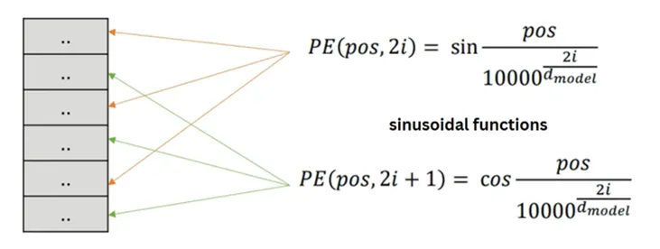
1.Absolute Positional Encoding (APE)
pos is the position of the token in the sequence. i is the index along the embedding dimensions.
d_model is the dimensionality of the model, often referred to as the hidden size or embedding size.
This helps the model differentiate between tokens based on their position in the sequence, which is crucial for understanding the order of words in natural language.
Chamabouabd

Slide 11
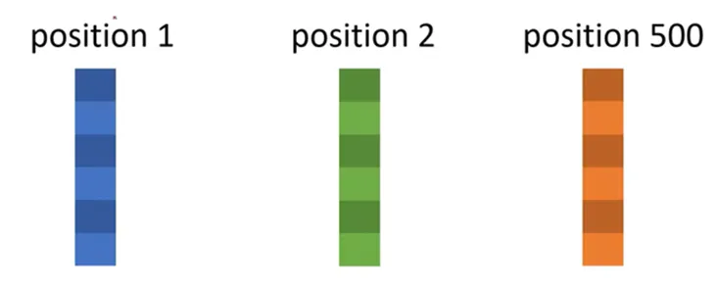
· the model can’t see any defiance between pos 2 and Pos 1 vs Pos 2 and 500
· the model in not aware that pos 1 ins near to Pos 2 compare to Pos 500 to pos 2
Absolute positional embeddings assign a unique vector to each position, which though straightforward, doesn’t scale well and fails to capture relative positions effectively. Relative embeddings, on the other hand, focus on the distance between tokens, enhancing the model’s understanding of token relationships but complicating the model architecture.
Chamabouabd

Slide 12
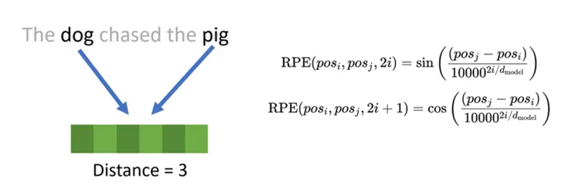
2. Relative Positional Encoding (RPE)
Traditional positional encodings like sine and cosine positional encodings work well but can be computationally expensive, especially for very long sequences
Chamabouabd

Slide 13
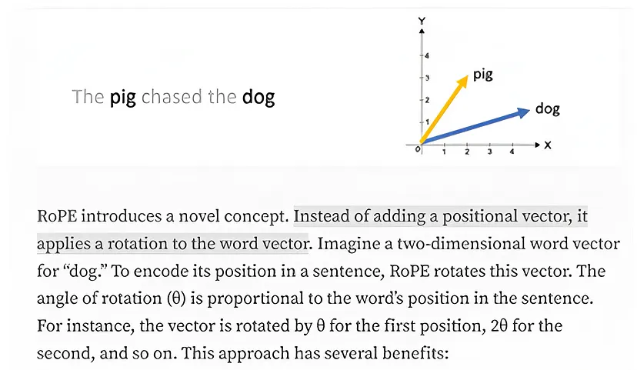
3. Rotary Positional Embeddings
Rotary Positional Encoding is a type of position encoding that encodes absolute positional information with a rotation matrix and naturally incorporates explicit relative position dependency in self-attention formulation
It encodes positional information in a way that allows the model to understand both the absolute position of tokens and their relative distances. This is achieved through a rotational mechanism, where each position in the sequence is represented by a rotation in the embedding space. The elegance of RoPE lies in its simplicity and efficiency, enabling models to better grasp the nuances of language syntax and semantics.
Chamabouabd

Slide 14
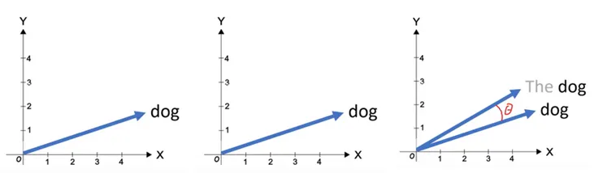
The rotary position embeddings are only applied to the query and the keys, but not the values.
· The rotary position embeddings are applied after the vector q and k have been multiplied by the W matrix in the attention mechanism, while in the vanilla transformer they’re applied before.
Chamabouabd

Slide 15
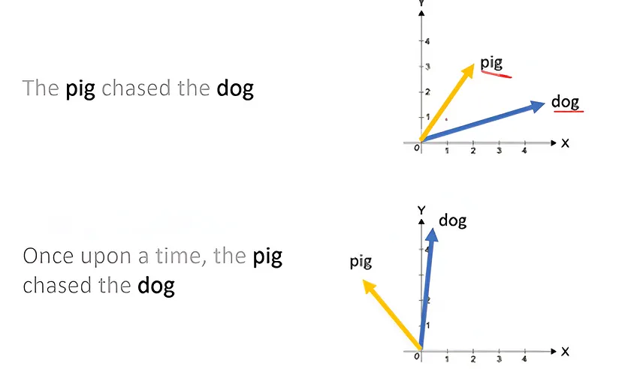
Preservation of Relative Positions: If two words, say “pig” and “dog,” maintain the same relative distance in different contexts, their vectors are rotated by the same amount. This ensures that the angle, and consequently the dot product between these vectors, remains constant.
Chamabouabd

Slide 16
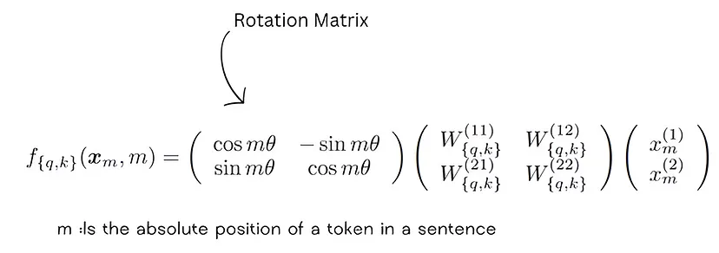
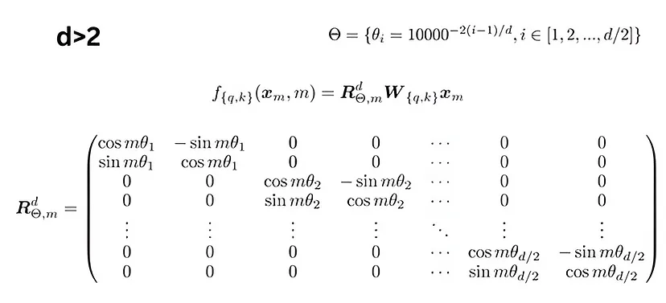
Chamabouabd

Slide 17
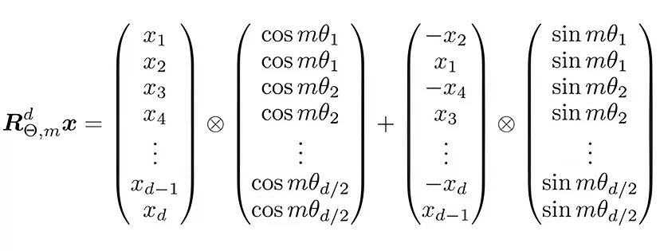
this is a sparce matrix if we work with this formula the computer will do a lot of computational that are useless because of zeros
The rotation is based on the position of each token in the sequence.
By doing this, RoPE introduces relative position information while preserving the original token information.
Chamabouabd

Slide 18
why Query Key and Value ?
In Transformer Architecture, the purpose of Query, Key, and Value is to learn relationships between different words in a sequence and capture dependencies across the sequence for tasks like machine translation and text generation. The Query is used to retrieve information from the Key-Value pairs that are relevant to a specific word or position in the sequence.
Why Not Rotate Values?
Rotating the values (embeddings) directly would alter the original content of the tokens.
The goal of RoPE is to maintain the semantic meaning of tokens while enhancing their positional understanding.
By rotating only the queries and keys, RoPE achieves this balance.
Chamabouabd

Slide 19
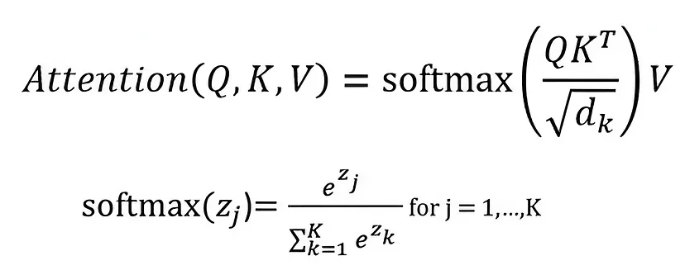
what is Self-Attention ?
Self-Attention allows the model to relate words to each other.
Chamabouabd

Slide 20
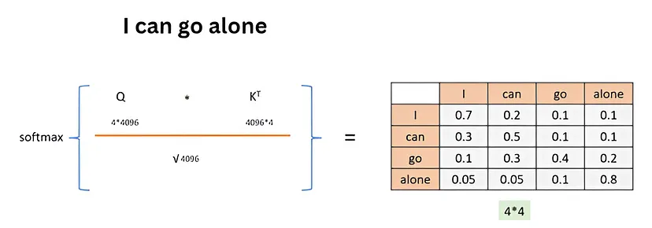
Self-attention is a mechanism in deep learning that allows a model to weigh the importance of different words in a sentence when predicting or generating the next word in the sequence. It helps the model focus on relevant parts of the input sequence by calculating attention scores for each word based on its relationship with other words in the sequence.
Remainder: “Relevance” refers to the degree of importance or significance that something has in relation to a particular context, task, or situation. It indicates how closely connected or applicable something is to the matter at hand, often implying its usefulness or impact on the outcome.
Chamabouabd

Slide 21
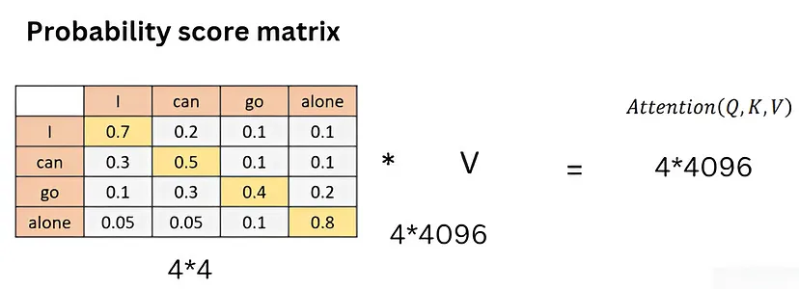
Definition:
An autoregressive model is a type of statistical model used for time series data, where the current value in the series is predicted based on its previous values. The model assumes that the current observation is a linear combination of one or more past observations with some added noise.
This model is an autoregressive model that’s mean that the next token depends only the previous token
in the attention Mecanique we don’t want to relate word with future words
Chamabouabd

Slide 22
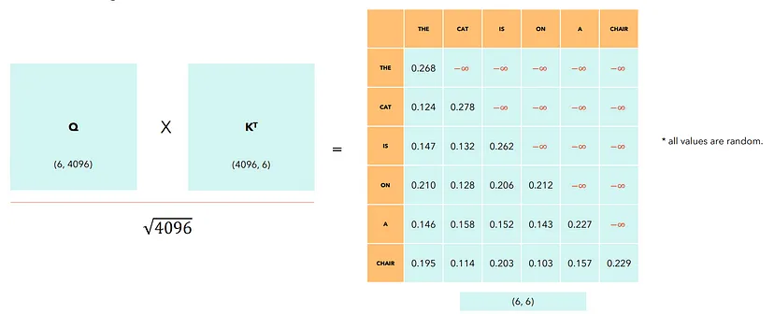
Chamabouabd

Slide 23
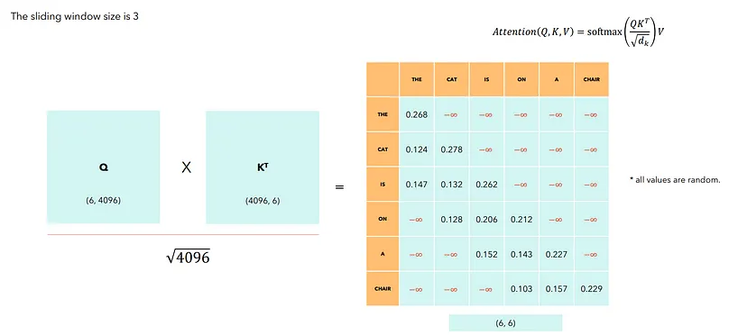
Sliding Window Attention
The model mostly focuses on the local context, which depending on the size of the window, is enough for most cases.
chair is stile related to to the indirectly
Chamabouabd

Slide 24
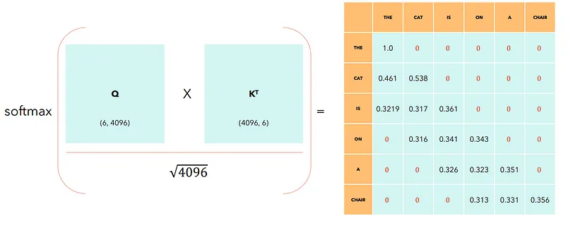
After applying the softmax, all the -Infinity have become 0, while the other values in the row are changed in such a way that they sum up to one. The output of the softmax can be thought of as a probability distribution.
Chamabouabd

Slide 25
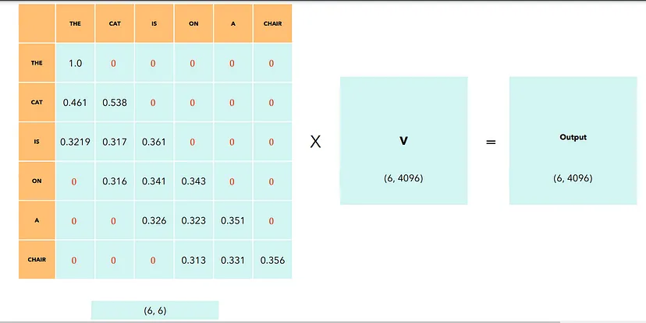
Chamabouabd

Slide 26
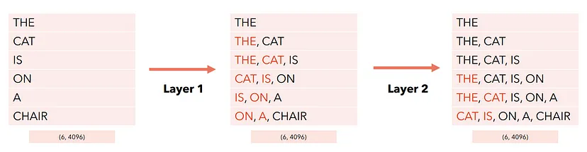
The output of the Self-Attention is a matrix of the same shape as the input sequence, but where each token now captures information about other tokens according to the mask applied. In our case, the last token of the output captures information about itself and the two preceding tokens.
but now each token captures more information about other tokens
Chamabouabd

Slide 27
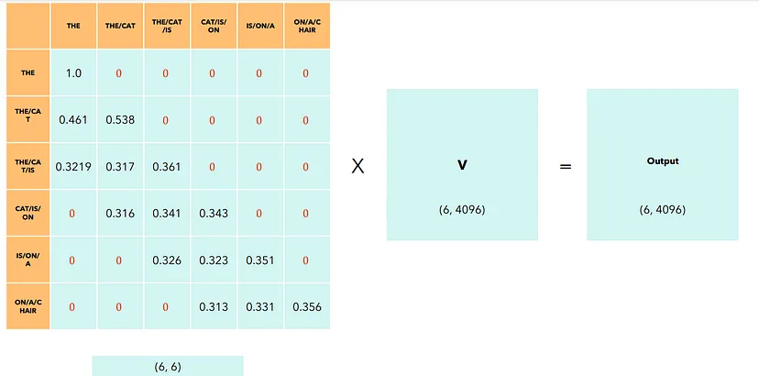
With a sliding window size W = 3, every layer adds information about (W — 1) = 2 tokens. This means that after N layers, we will have an information flow in the order of W x N.
The model try to understand the meaning of the words the synonym, the words that comes together the words that the word in the same Domaine
Chamabouabd

Slide 28
At this stage the model try to understand and capture the relationship between the new combination of tokens
This next token depends directly on 4096 Token of the previous layers, but indirectly on all tokens of the initial layers, since each Token of the intermediate layer depends on 4096 token of the previous layer. This means that a change in any of the features of the layer 1 will influence this token as well.
· Reduces the number of dot-products to perform, and thus, performance during training and inference.
· Sliding window attention may lead to degradation in the performance of the model, as some “interactions” between tokens will not be captured.
Chamabouabd

Slide 29
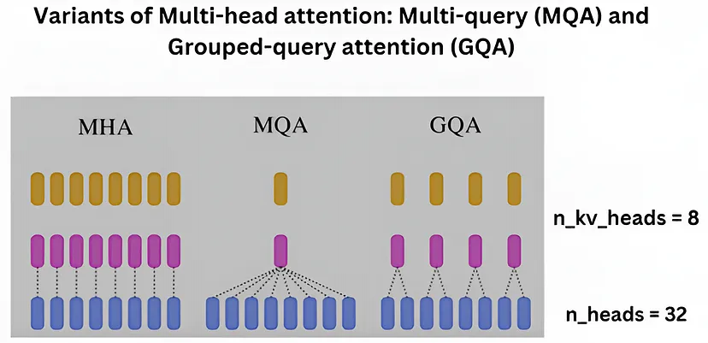
Grouped Query Attention (GQA)
Chamabouabd

Slide 30
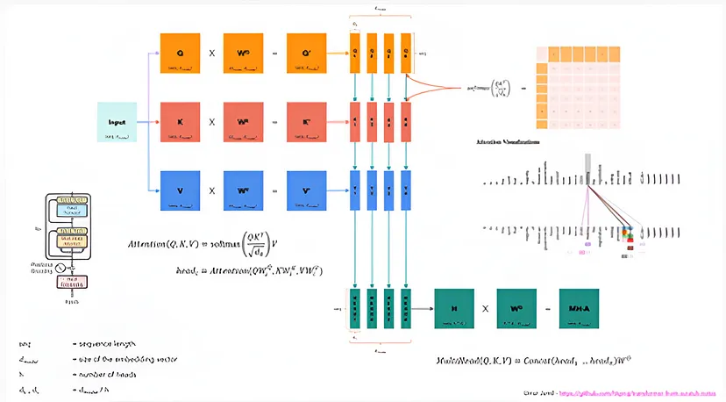
Chamabouabd

Slide 31
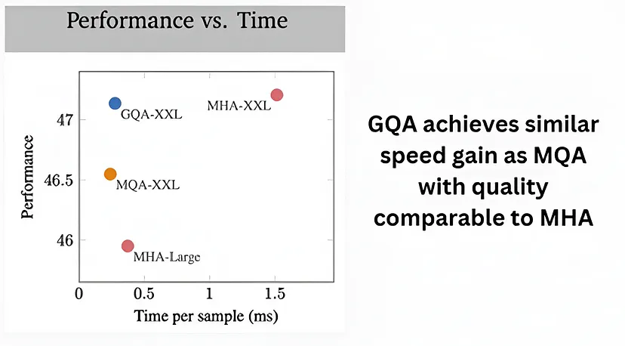
Chamabouabd

Slide 32
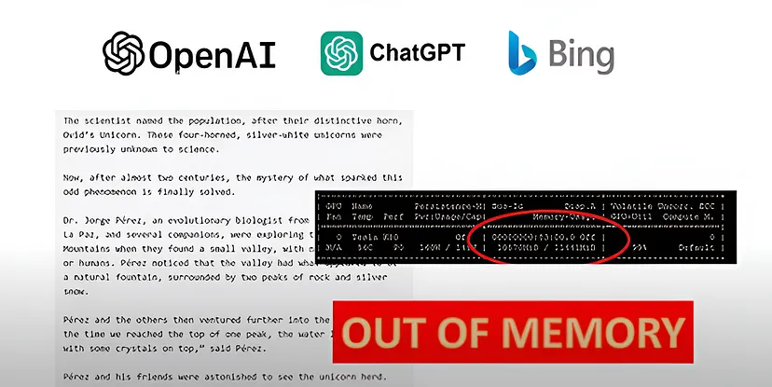
KV-Cache with Rolling Buffer Cache
the kv cach improve the speed of the model by allowing them to focus on specific parts of the input data this is done by avoid redundant computations.
Chamabouabd

Slide 33
When the model generates text it will use more and more GPU memory eventually you reach a point where your GPU runs out of memory your programe is crashes and you cannot generate any more text LLMs require more memory when generating text .
Rolling Buffer Cache
Definition:
· A Rolling Buffer Cache is a memory management technique used to reduce the memory footprint of certain algorithms or models.
· It employs a fixed attention span to limit the cache size, ensuring that memory usage remains manageable.
Why transformer Models require more memory when when it deals with longer text ?
what happens in the self-attention mechanism when we generate a sentence ?
This is where KV comes into play. By caching the previous Keys and Values, we can focus on only calculating the attention for the new token.
Chamabouabd

Slide 34
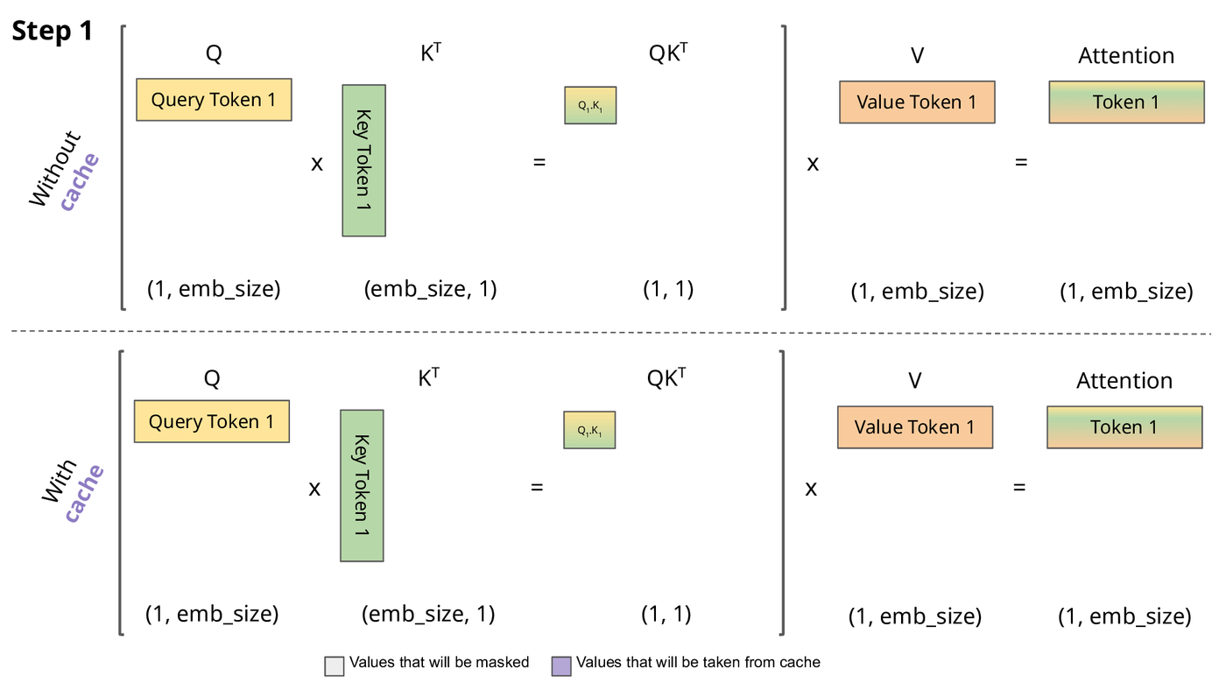
Why is this optimization important? As seen in the picture above, the matrices obtained with KV caching are way smaller, which leads to faster matrix multiplications. The only downside is that it needs more GPU VRAM (or CPU RAM if GPU is not being used) to cache the Key and Value states.
Chamabouabd

Slide 35
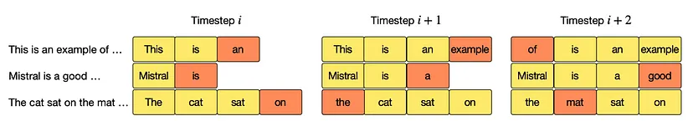
The K and V matrices contain information about the entire sequence but the query Vector only contains information about the last token that we have seen
Pre-fill and chunking
When generating text using a Language Model, we use a prompt and then generate tokens one by one using the previous tokens. When dealing with a KV-Cache, we first need to add all the prompt tokens to the KV-Cache so that we can then exploit it to generate the next tokens.
Since the prompt is known in advance (we don’t need to generate it), we can prefill the KV-Cache using the tokens of the prompt. But what if the prompt is very big? We can either add one token at a time, but this can be time-consuming, otherwise we can add all the tokens of the prompt at once, but in that case the attention matrix (which is N x N) may be very big and not fit in the memory.
Chamabouabd

Slide 36
The solution is to use pre-filling and chunking. Basically, we divide the prompt into chunks of a fixed size set to W (except the last one), where W is the size of the sliding window of the attention.
what if the prompt is very big?
We can add all the tokens of the prompt at once, but in that case the attention matrix (which is N x N) may be very big and not fit in the memory.
The solution
use pre-filling and chunking. Basically, we divide the prompt into chunks of a fixed size set to W (except the last one), where W is the size of the sliding window of the attention.
Chamabouabd

Slide 37
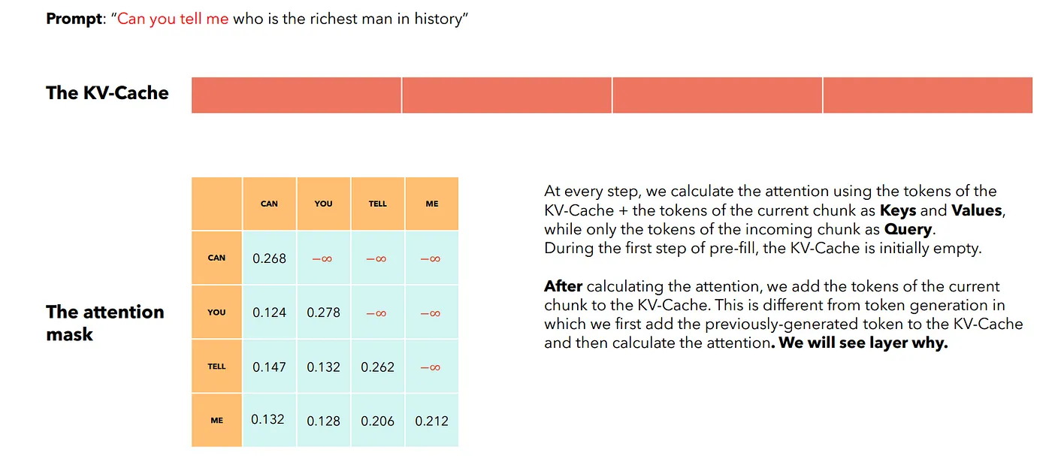
Pre-fill and chunking: first chunk
Chamabouabd

Slide 38
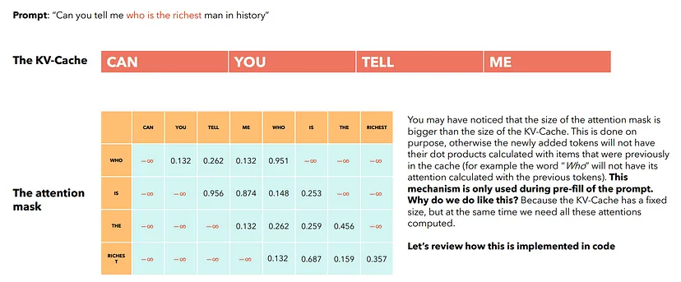
Pre-fill and chunking: second chunk
Chamabouabd

Slide 39
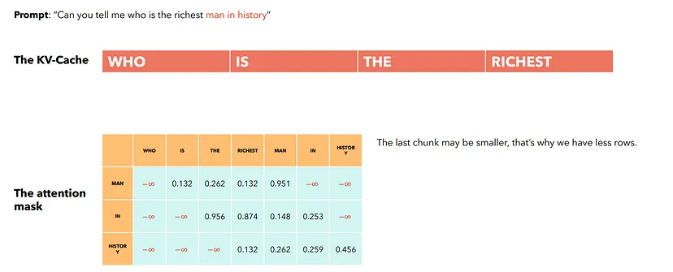
Pre-fill and chunking: last chunk:
Chamabouabd

Slide 40
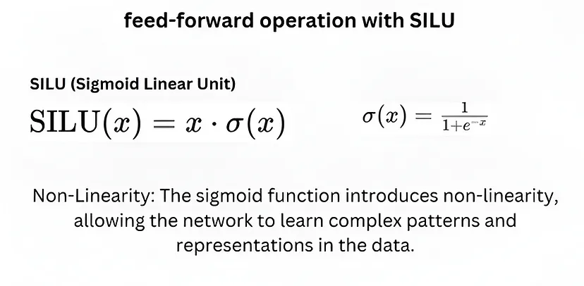
feed-forward operation with SILU
The feed-forward operation with SILU (Sigmoid-weighted Linear Unit) involves passing the input data through a neural network layer where the activation function used is SILU. SILU is also known as SiL or Swish-1, and it is defined as 𝑓(𝑥)=𝑥⋅𝜎(𝑥), where 𝜎(𝑥) represents the sigmoid function. This activation function has been found to perform well in deep learning applications.
Chamabouabd

Slide 41
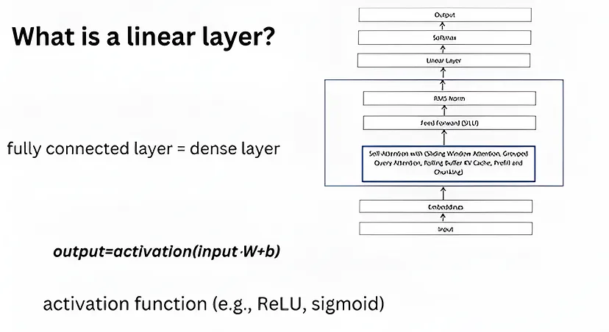
linear layer:
A linear layer, also known as a fully connected layer, is a type of layer in neural networks where each neuron in the current layer is connected to every neuron in the next layer. It performs a linear transformation on the input by multiplying it with a weight matrix and adding a bias term. This transformation helps the network learn complex patterns and relationships in the data.
Chamabouabd

Slide 42
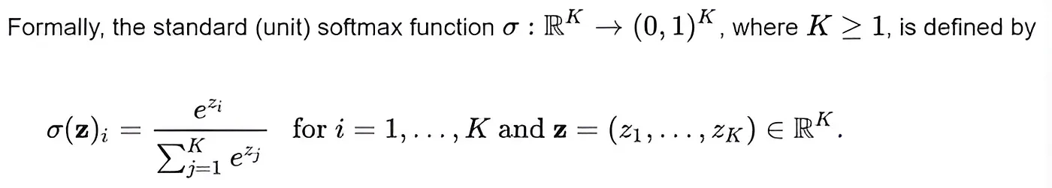
Softmax
In conclusion, Mistral 7B represents a significant advancement in language modeling, showcasing unparalleled performance and efficiency that pave the way for transformative applications in various domains.
Chamabouabd

